Slide 1




OPEN SOURCE DATA VISUALIZATION (COVID-19)
LEAP ACADEMY

Slide 2
PRESENTATION BY TRIBE-I :
UNDER THE GUIDENCE OF:DINESH BEHERA
TRIBE MEMBERS NAMES:-
1. ABHIJEET MAHINDRAKAR
2. RITUPRIYA
3. SALOMY

Slide 3

INTRODUCTION
The novel coronavirus (COVID-19) was widely reported to have first been detected in Wuhan (Hebei province, China) in December 2019. After the initial outbreak, COVID-19 continued to spread to all provinces in China and very quickly spread to other countries within and outside of Asia.
Analyses on North and South America have also used similar classical methods, for example model the progression of the outbreak in the United States until the end of pandemic.
However, other studies include : analysis of the spatial variability of the incidence in the United States using spatial lag and error models, and geographically weighted regression estimation of the number of deaths in the United States using a modified logistic fault-dependent detection model.
It estimates prevalence and infection rates across different states in the United States using a sample selection model investigating the relationship between social media communication and the incidence in Colombia using non-linear regression models.

Slide 4
However, societal issues have been exacerbated note that the reduction in the labour force that has resulted from controlling for COVID-19 has affected ethnic minorities and women most significantly. As a result of this on going pandemic, new results and reports are being produced and published daily. Thus, our motivation stems from wanting to contribute to the statistical analysis of the incidence of COVID-19 in Italy and Spain, where the literature is limited. The main contributions of this paper are: i) To model the incidence of COVID-19 in Italy and Spain using simple mathematical models in epidemiology. ii) To provide estimates of basic measures of the infectiousness and severity of COVID-19 in Italy and Spain. iii) To investigate the predictive ability of simple mathematical models and provide simple forecasts for the future incidence of COVID-19 in Italy and Spain.

Slide 5
OBJECTIVES
Granular data is also more transparent and informative for the general public. Governments cannot give personalized health recommendations to each citizen
It enables public health personnel to track the disease spread, vaccination, and adverse events across different sub-populations [. It also allows researchers to gain new insights, and to scrutinize the data to understand the rationale behind the policies put forth by the government.
Analysis and study the infection spreading throughout, using open source data visualization which features to extract the data. The tool will help to extract huge data of Countries.
Data visualization of covid 19 infection
Act aim to get the information of covid cases across the world in the simple graphical formats.
This project aim analyze data on the number of infected people in each Indian state (restricted to only those states with enough data for prediction) .
This project also aim to get result data of infected patient, cured patient and different variant of Covid-19.

Slide 6
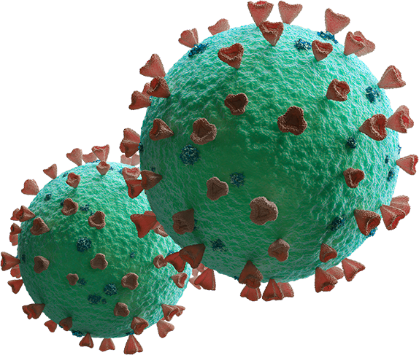
Problem Statement
The pandemic has already taken grip over peoples’ life. Since the start of the pandemic, some countries are facing problem of ever-increasing cases. Through the data analysis of cases one can analyze how countries all over the world are doing in terms of controlling the pandemic.
Deficiency of Data over death and Recovered from Covid-19 across the world.
Lack of Data available to covid-19 detection and Cure.
Data over the Senior citizen, adult and children who are infected and cured around the world
This project will supervised learning technique is used for detection of Covid-19 and analysis of the consequence

Slide 7
PROPOSED SYSTEM
Proposed project will be dealing different Covid cases across India.
This cases are concern of Government and different organization dealing with it.
The data will be segregated and process the data obtained from it.
One of the main features of this project is to visualize the data using open source data visualization tool.
Various studies have been conducted on the COVID-19 with different data visualization tools to analysis the spread to COVID.
This data obtained from the output will be used by state government to organize various policy for people who suffered during panic directly or indirectly.

Slide 8
REQUIREMENT SPECIFICATIONS
Hardware Requirement:
Processor : Intel i3 or Above or AMD processor
RAM: Min 4GB and above.
Hard Drive: Min 250GB and above
GPU (optional)

Slide 9
Software Requirements
Google Colab or Jupiter Book
Kaggle Library
Dataset related to Covid-19
Libraries Used :
Pandas : Working with data files
Numpy : for Scientific Calculation
3) Matplotlib : Basic Visualization
Plotly : Advance Visualization
5) Folium : Open Source Data Visilualization Tool.

Slide 10
Flow Diagram
Time-line series of Covid-19 State wise
Covid-19 Data for India
Pre-processed Covid-19 Data for India
Time-line series of Covid-19 India(Recovered/death)
Extract the Relevant Data
Prediction Analysis of using various Regression model

Slide 11
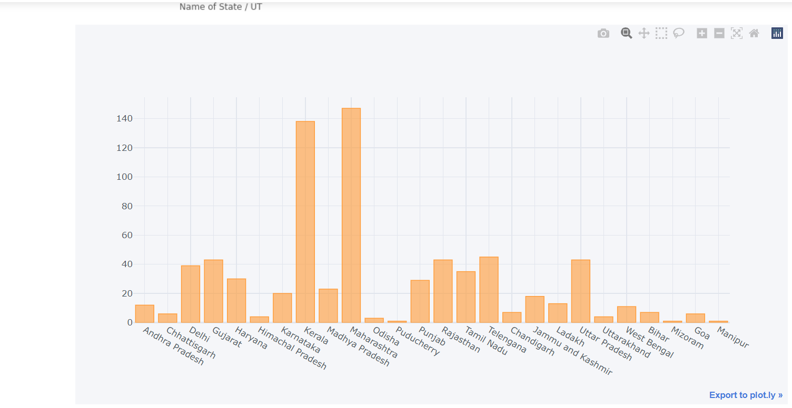
Data-flow diagram of COVID-19 Analysis of India.
From the above diagram Covid -19 Data of India, which are unorganized will be taken into consideration for further processing, this further will be pre-processed and organized, and the real time data will be extracted using time series, this data will be arranged, according to recovered and the death.
Cases across the different states

Slide 12
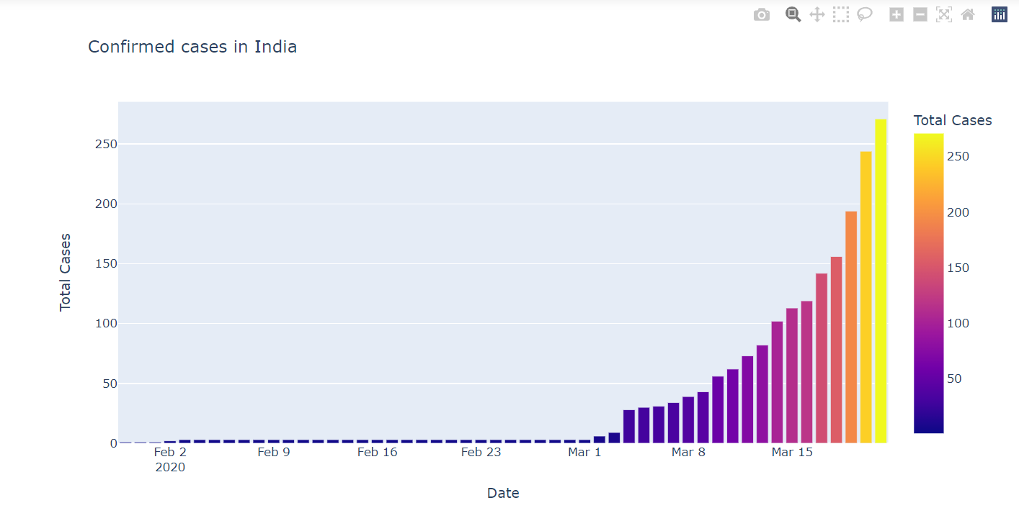
This data will be put together and the relevant data will be extracted from it. The generated data will be in numerous amount. To enhance this data, this data will visilualized and further analyzed to graphs and Charts.
Confirmed Cases in India

Slide 13
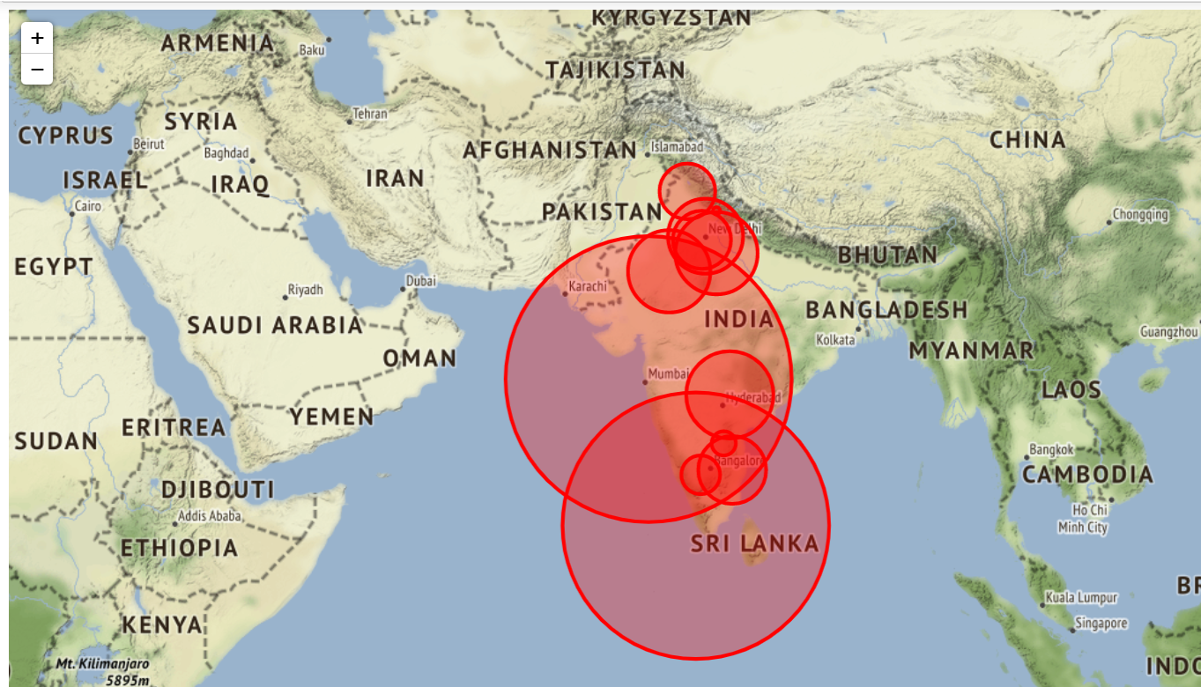
Epic Center of highest covid cases across India

Slide 14
ADVANTAGES AND DISADVANTAGES
Advantages :
Easy to analysis the data on using the open source data visualization tool.
Getting the information and represent Demography of huge amount of data becomes easy.
Easy to analysis the infection spread and confirmed cases across the country.
Analysing the recovered patient across the country becomes easy.
Disadvantages:
Dataset are not easily available.
Complex process for Data visualization.

Slide 15
CONCLUSION
Through this project, the analysis on COVID-19 data has been performed successfully. The analysis on this pandemic spread has been done and compared between different countries. The analysis of confirmed cases, active cases, recovered cases and deaths are done separately to give a clear look on how the virus is spreading, which countries are getting affected mostly and how different countries are recovering. A separate analysis on cases of INDIA has been done and predictions of different cases both around the world and INDIA has been done. At last, the accuracy check using different metrics is performed over all the analysis done in this project

Slide 16
REFERENCES
[1] Liu C, Zhou Q, Li Y, Garner LV, Watkins SP, Carter LJ, et al. Research and Development on Therapeutic Agents and Vaccines for COVID-19 and Related Human Coronavirus Diseases. ACS Central Science. 2020;6(3):315–331. pmid:32226821
[2] Chen X, Han W, Wang G, Zhao X. Application prospect of polysaccharides in the development of anti-novel coronavirus drugs and vaccines. International Journal of Biological Macromolecules. 2020;164:331–343. pmid:32679328
[3] Kim E, Erdos G, Huang S, Kenniston TW, Balmert SC, Carey CD, et al. Microneedle array delivered recombinant coronavirus vaccines: Immunogenicity and rapid translational development. EBioMedicine. 2020;55:102743. pmid:32249203.
[4] de León UAP, Pérez ÁG, Avila-Vales E. An SEIARD epidemic model for COVID-19 in Mexico: mathematical analysis and state-level forecast. Chaos, Solitons & Fractals. 2020;140:110165.

Slide 17
THANK YOU

